Slide 1

Comite point d’eau (C.P.E)
This user guide will help you navigate to this console. And display the features available.

Slide 2
C.P.E
How to access the console?
Access the mWater portal.
Access the HANWASH portal.

Slide 3
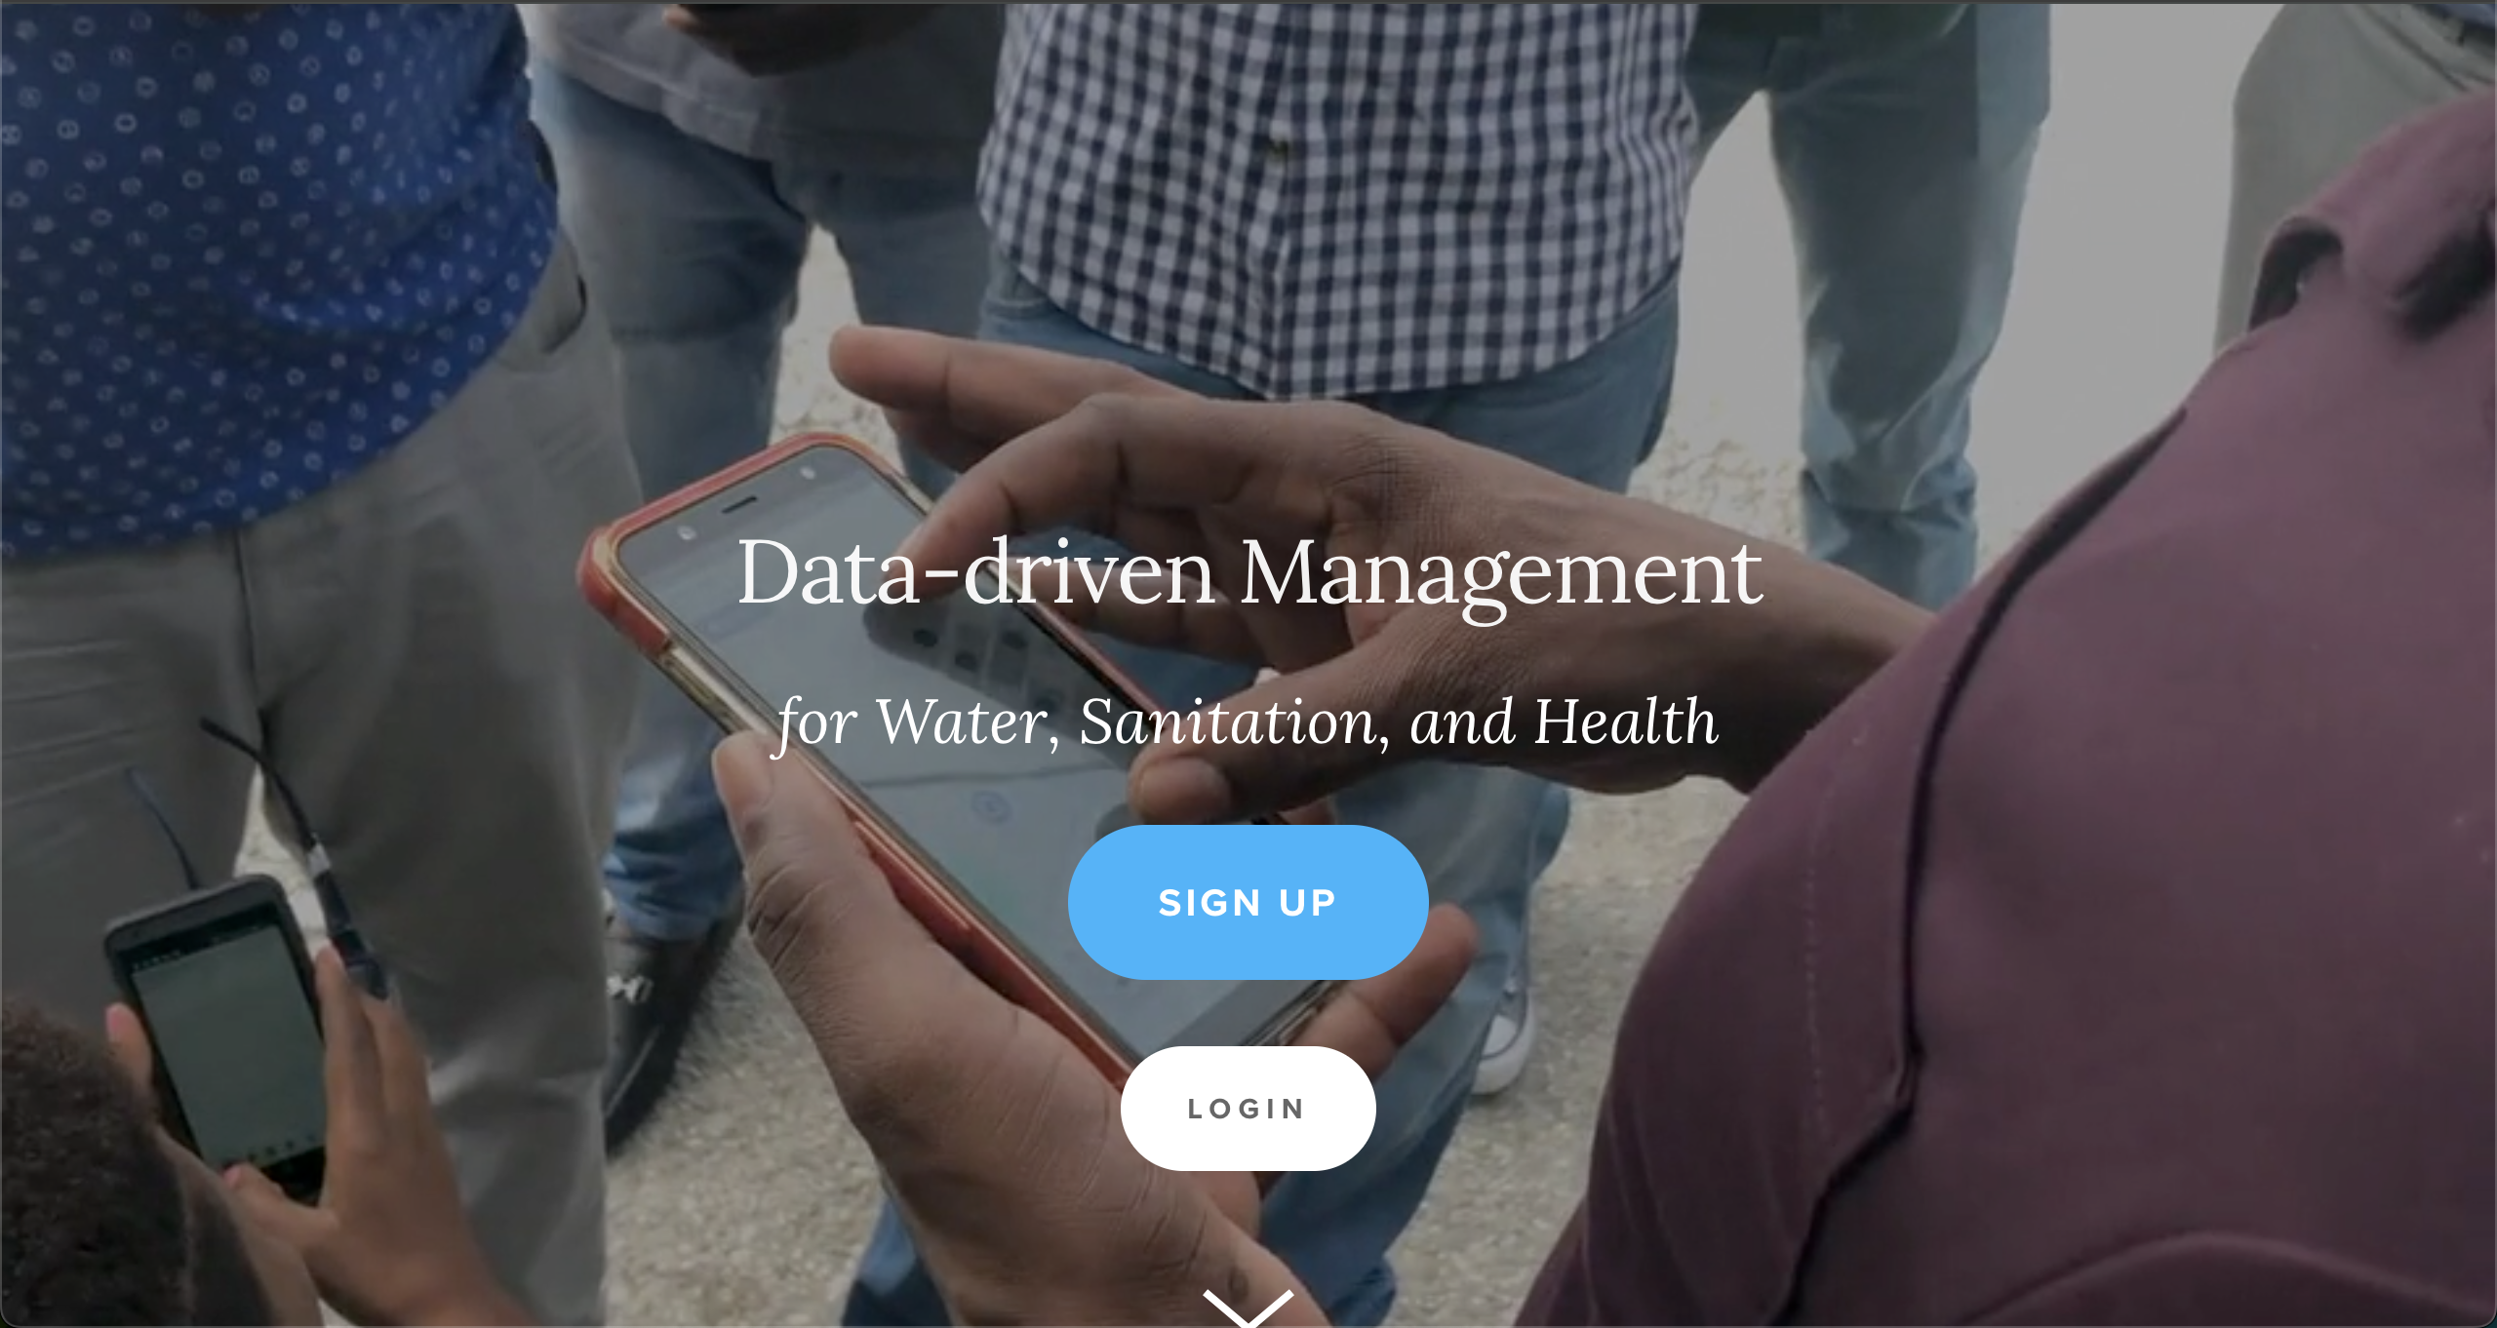
Mwater Home
URL LINK : https://www.mwater.co

Slide 4
Authenication PRocess
Click on the Login button.

Slide 5
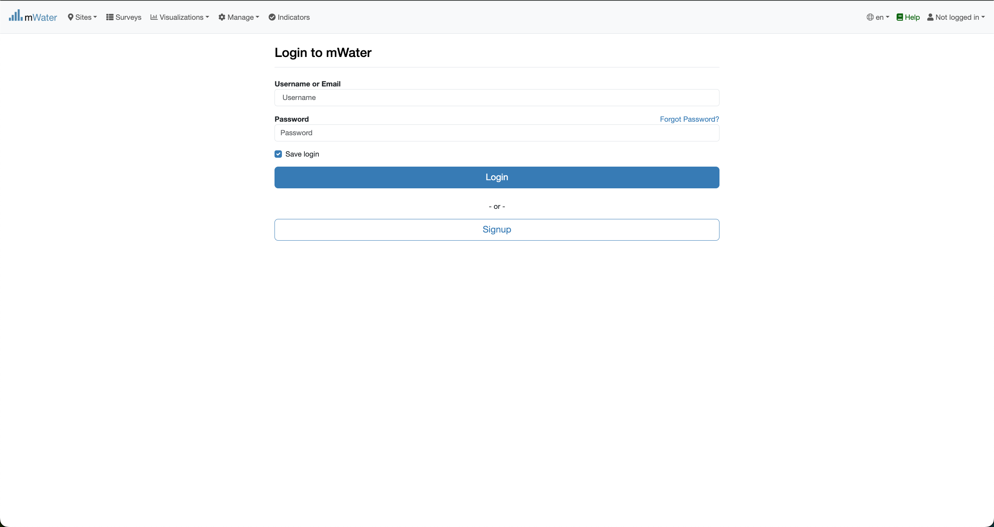
Authentication PRocess
You are not logged in.
Fill with your credentials and click on the log button.

Slide 6
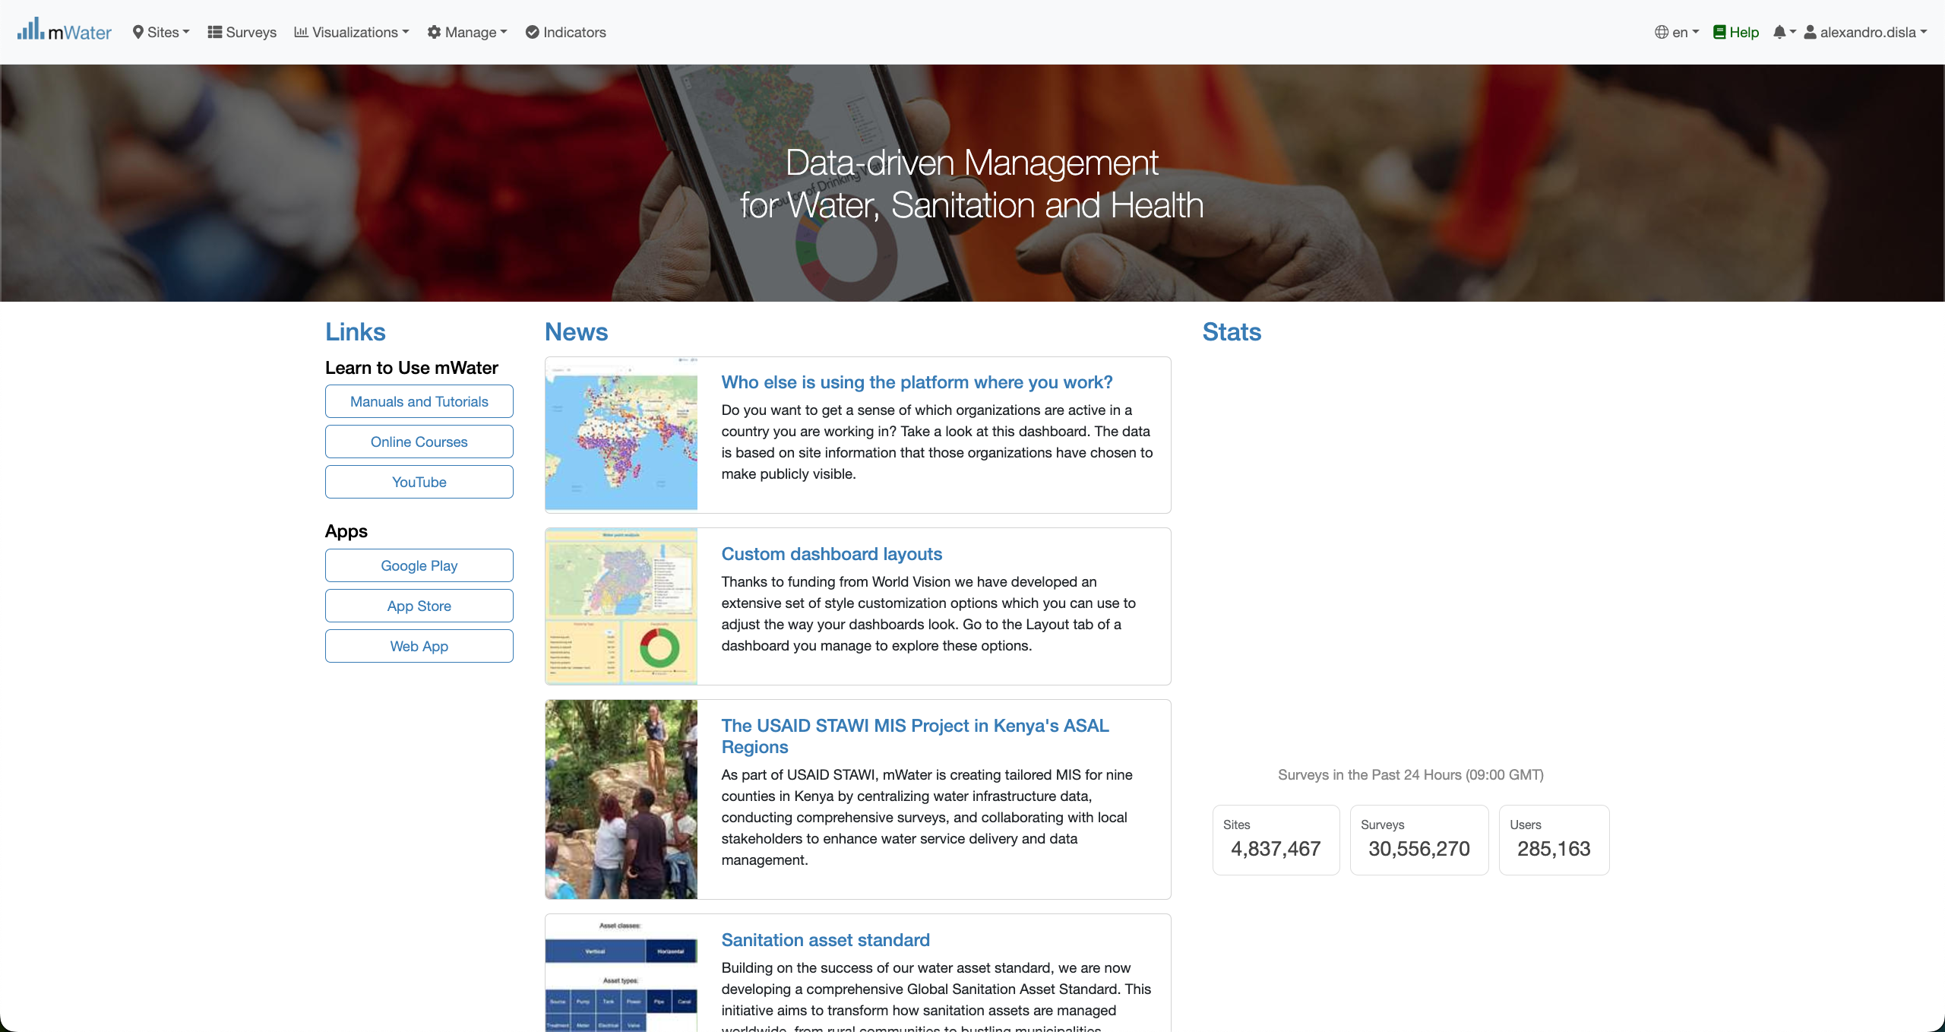
Mwater Home page Portal
You have successfully logged in.

Slide 7
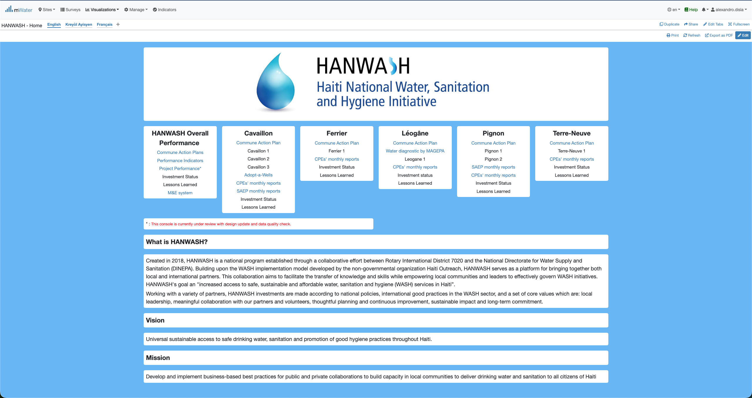
Hanwash HOME
After you have been logged in mWater. Please use this link in your browser to access the HANWASH HOME CONSOLE, quickly.
URL LINK : http://go.mwater.co/hanwash

Slide 8
Access the CPE CONSOLES
Please select the CPE Monthly reports, highlighted by their respective commune. The text in blue are clickable links

Slide 9
Console Overview
We have two page in the console. Please select the version of your pleasing.
1. CPE Reports (English Version)
2. Rapport CPE (French version)

Slide 10
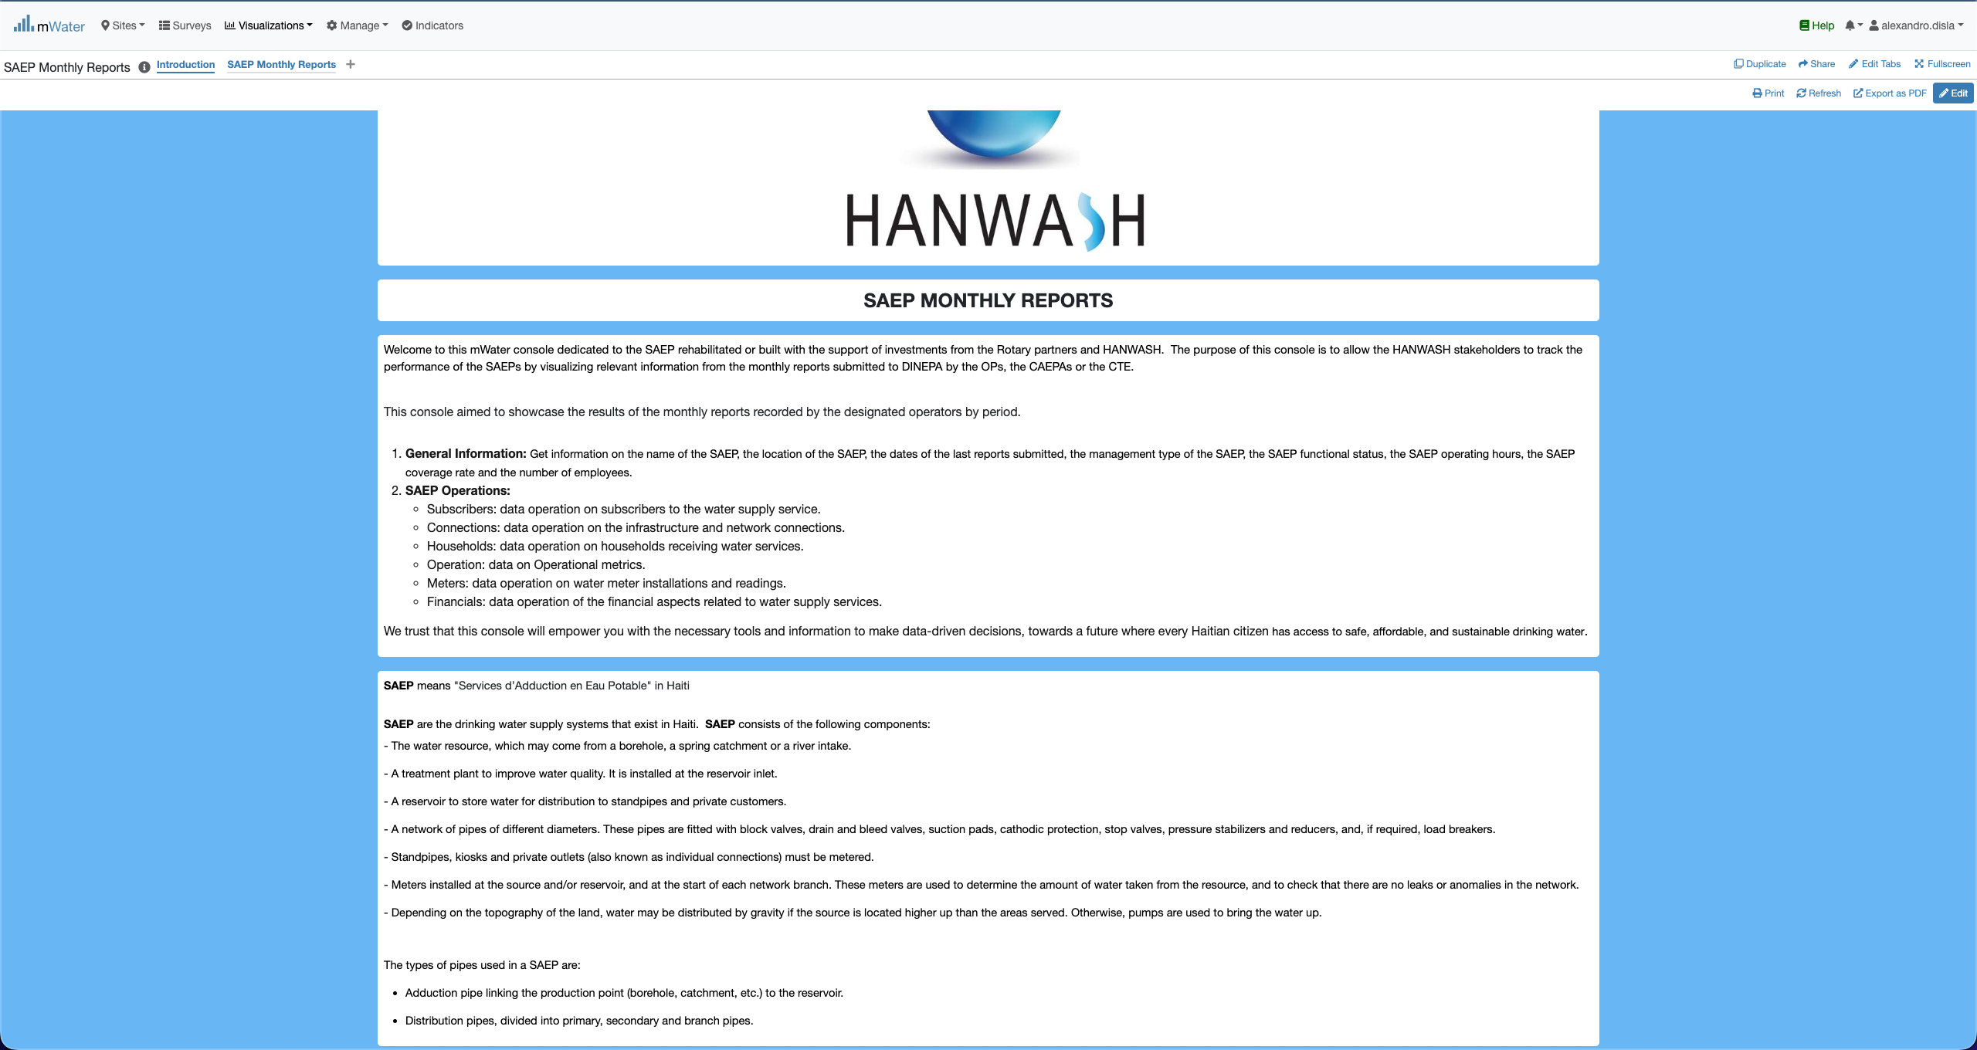
S.A.E.P Console overview

Slide 11
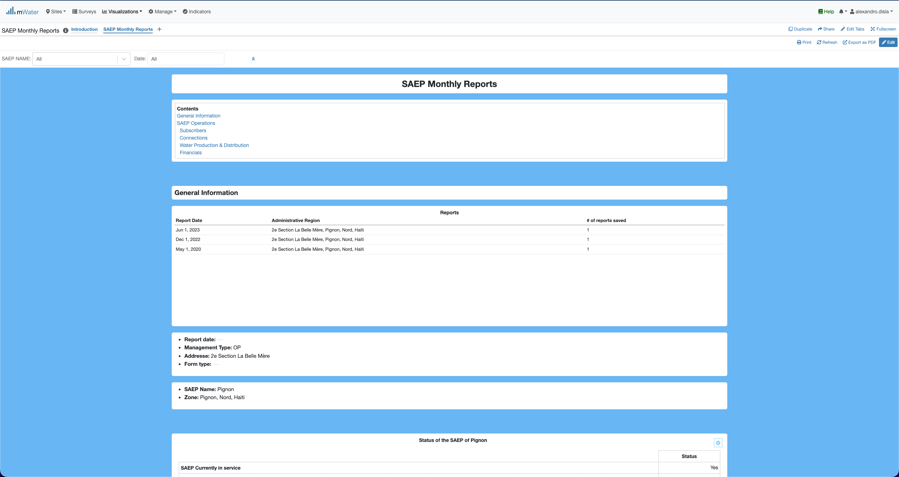
S.A.E.P Console overview

Slide 12
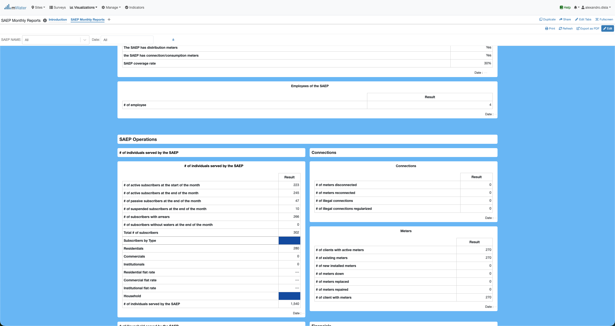
S.A.E.P Console overview

Slide 13
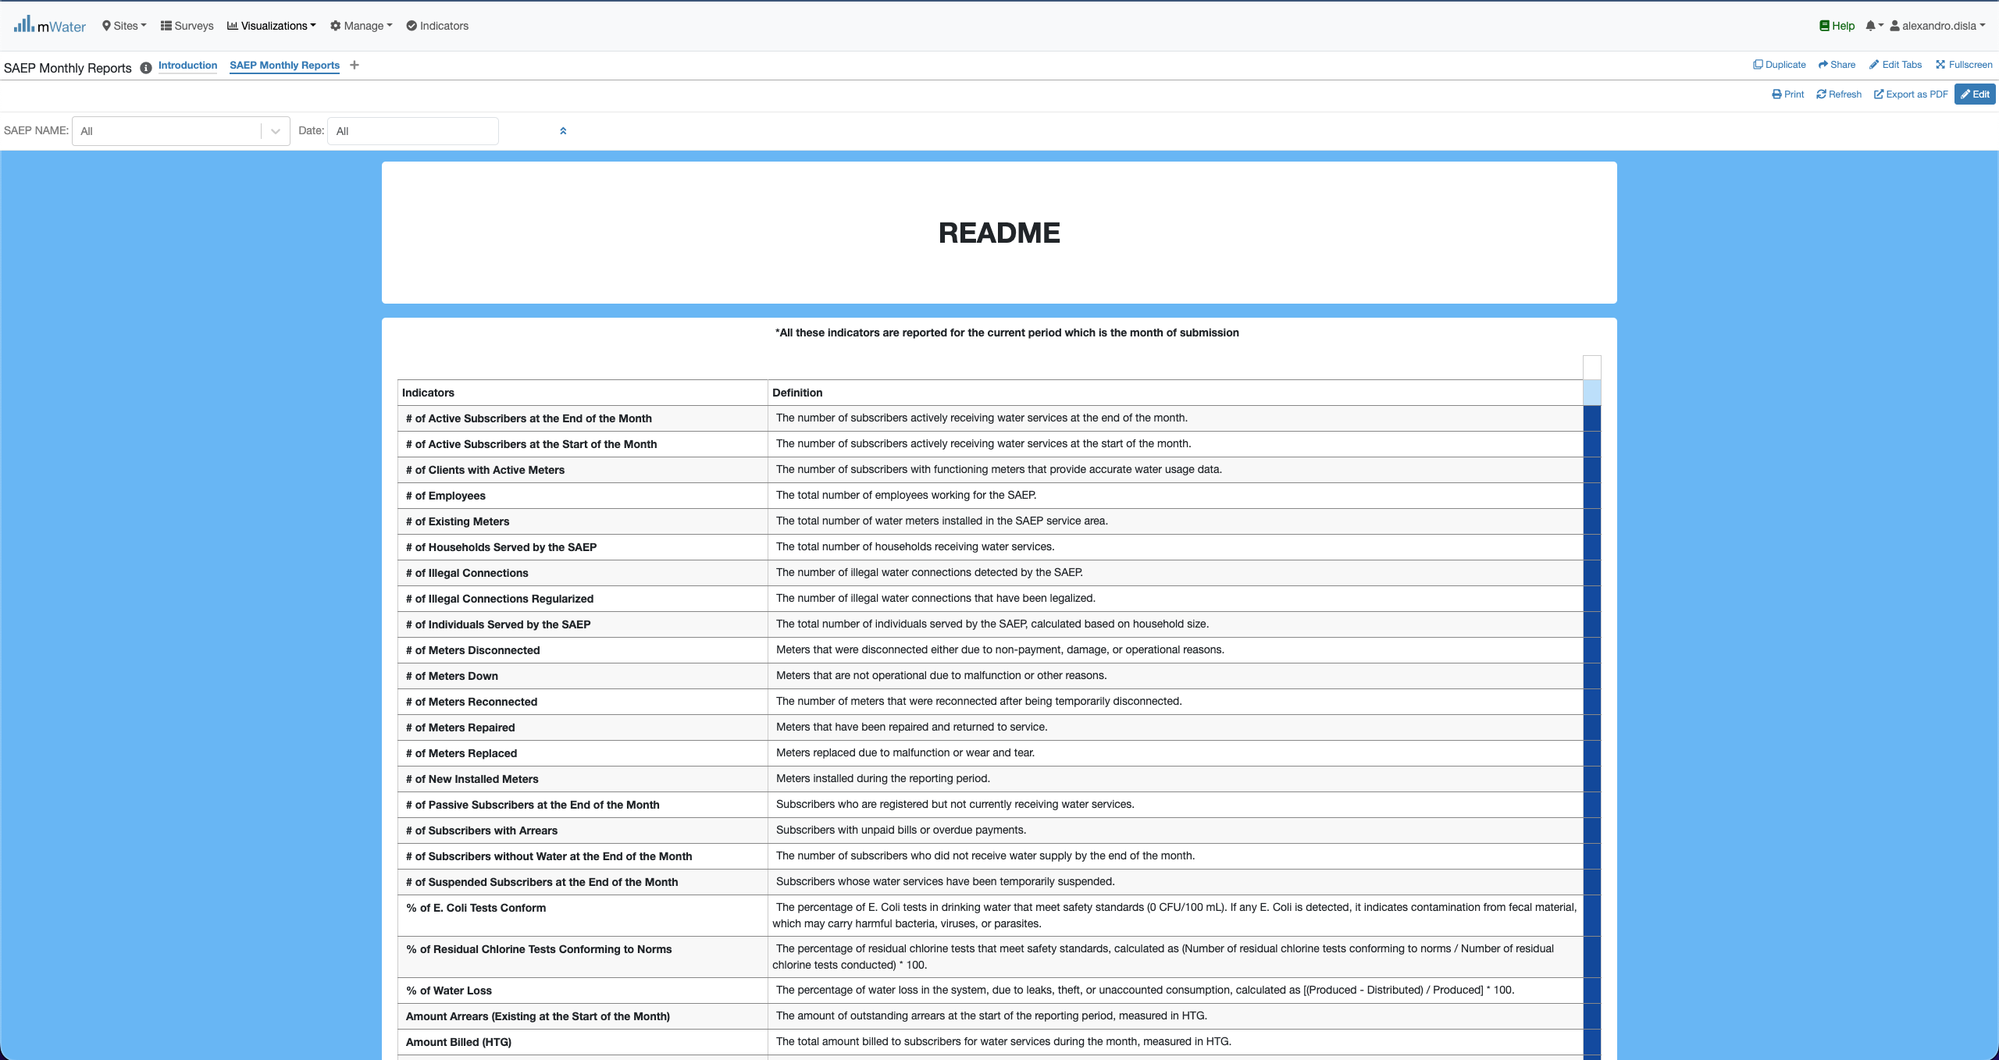
S.A.E.P Console overview

Slide 14
Functionalities
What are functionalities available?

Slide 15
The Main page
SAEP Monthly Reports:
General Information
SAEP Operations
Subscribers
Connections
Water Production & Distribution
Financials

Slide 16
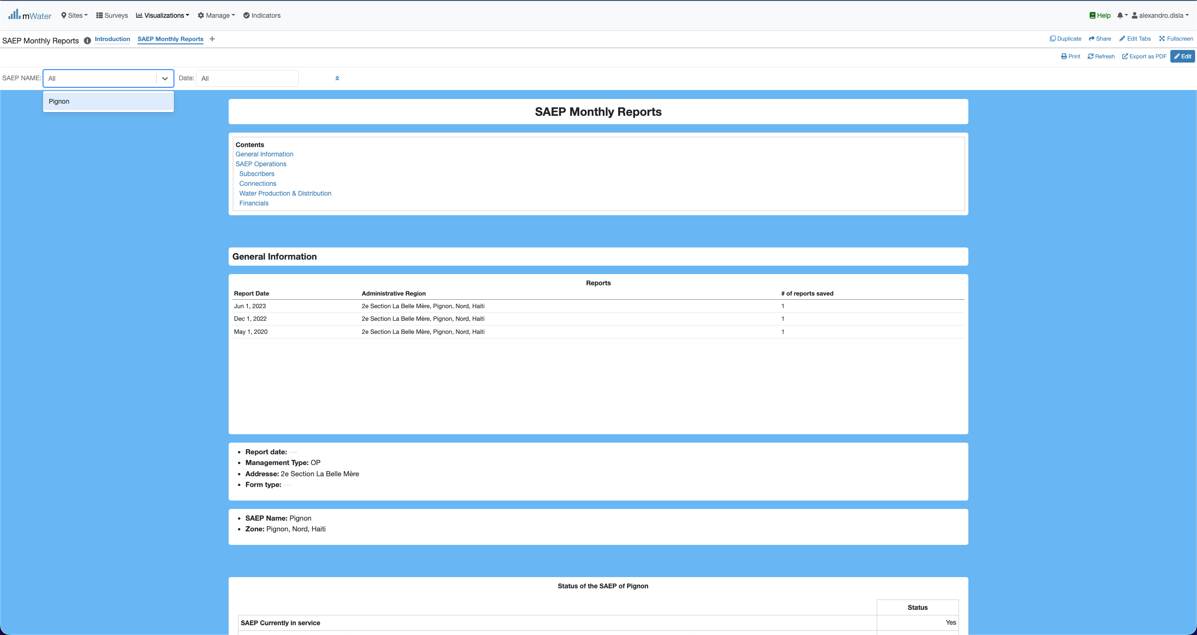
Quick filters
The SAEP Name and any future saep will be display in this dropdown list.

Slide 17
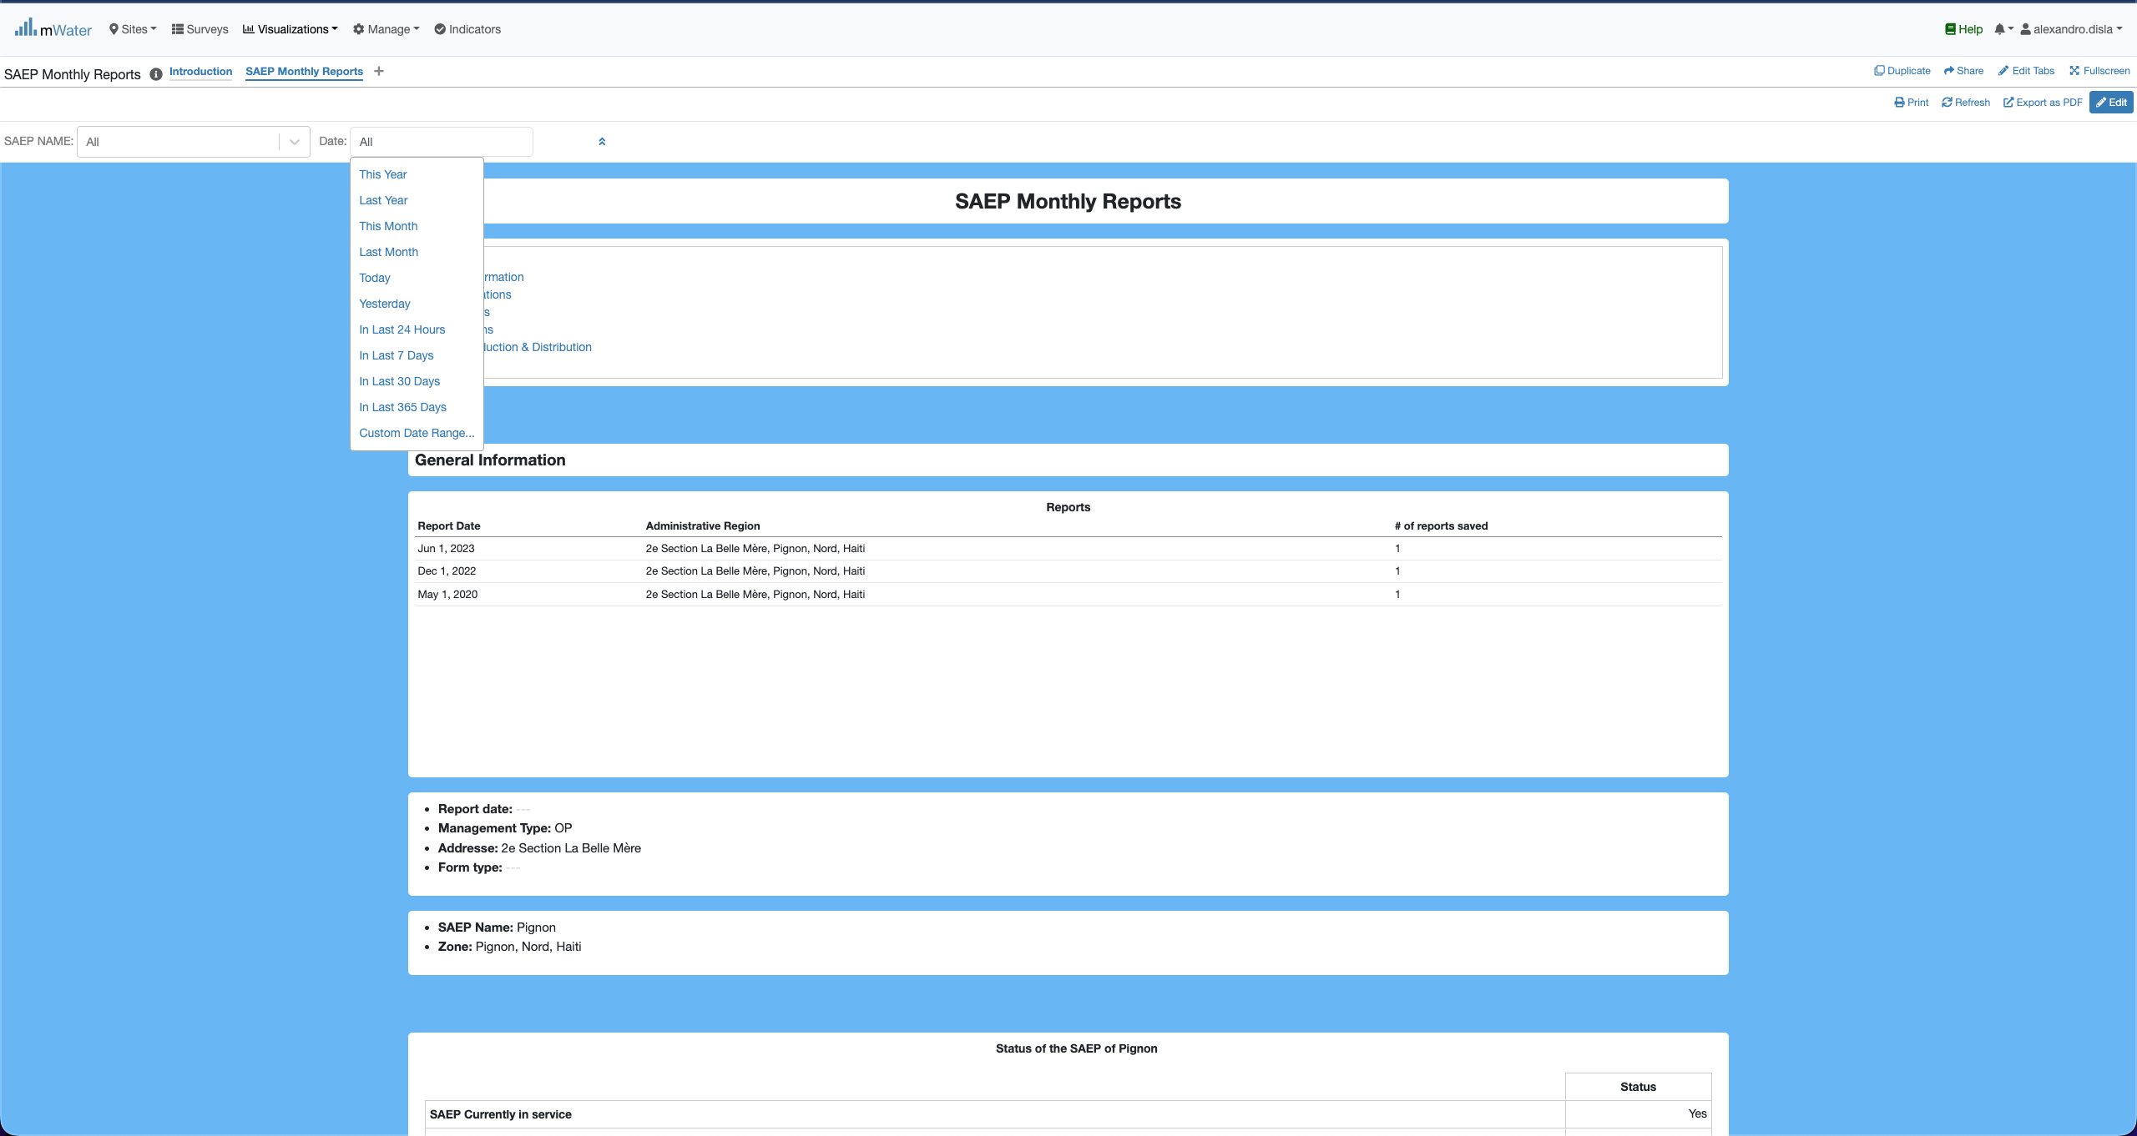
Quick filters
The Date offers us the full flexibility to work filter for a specific day or period.
This section will display all the available report for all the saep. Right now, it displays the reports for Pignon. It will help for the selection of the period.

Slide 18
How to select a report date
One of the main feature available on this Console

Slide 19
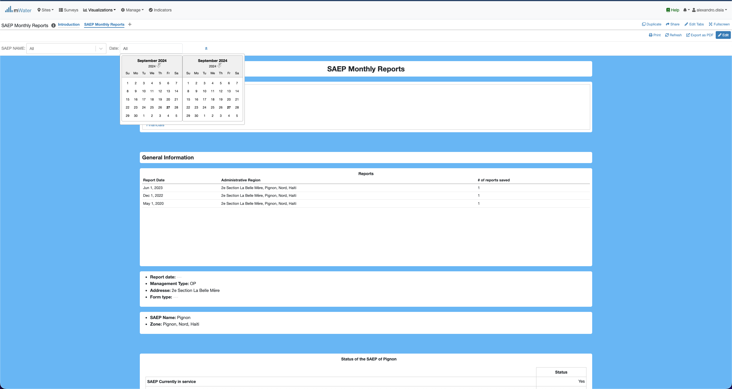
Report date
You have to have the selected in this format display lke this: 01 Jun 2023 – 01 Jun 2023
As indicated in the first table in below. We have 3 recorded reports date.

Slide 20
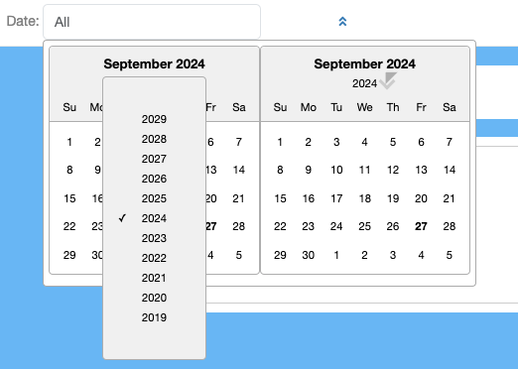
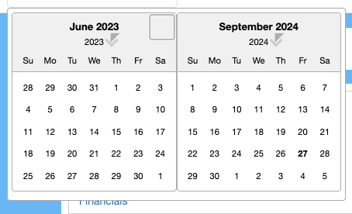
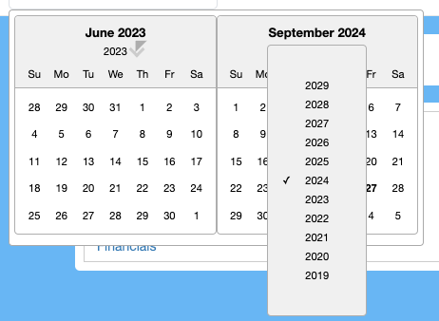
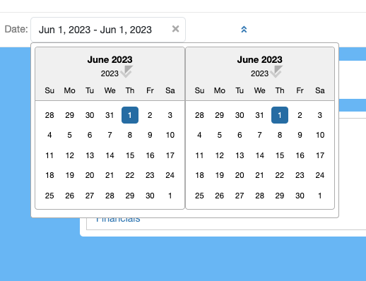
Report Date
Click on 2024, to display the month list
Click on the left or rigth side to change the months

Slide 21
Effect
Effect of The Quick Filters

Slide 22
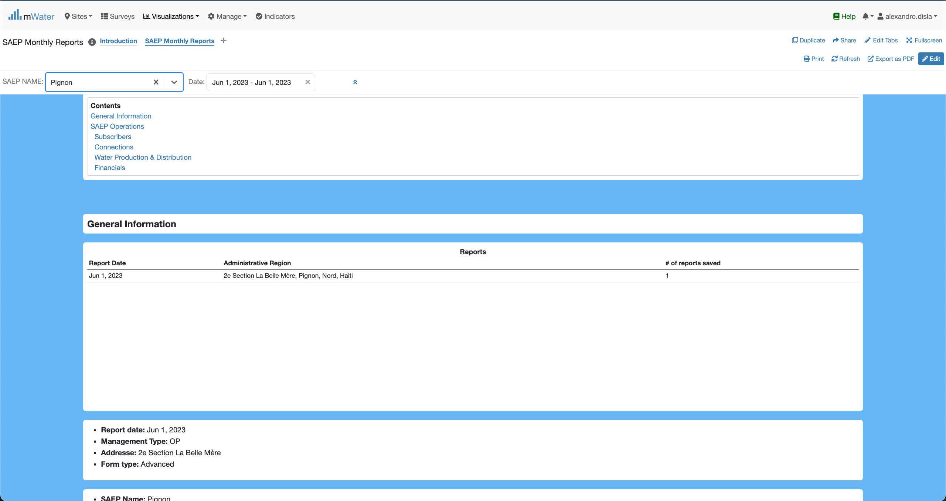
Quick Filters Selection
Now we have the date of a report selected. Plus we can add the saep name.
All the component will react to display the available results

Slide 23
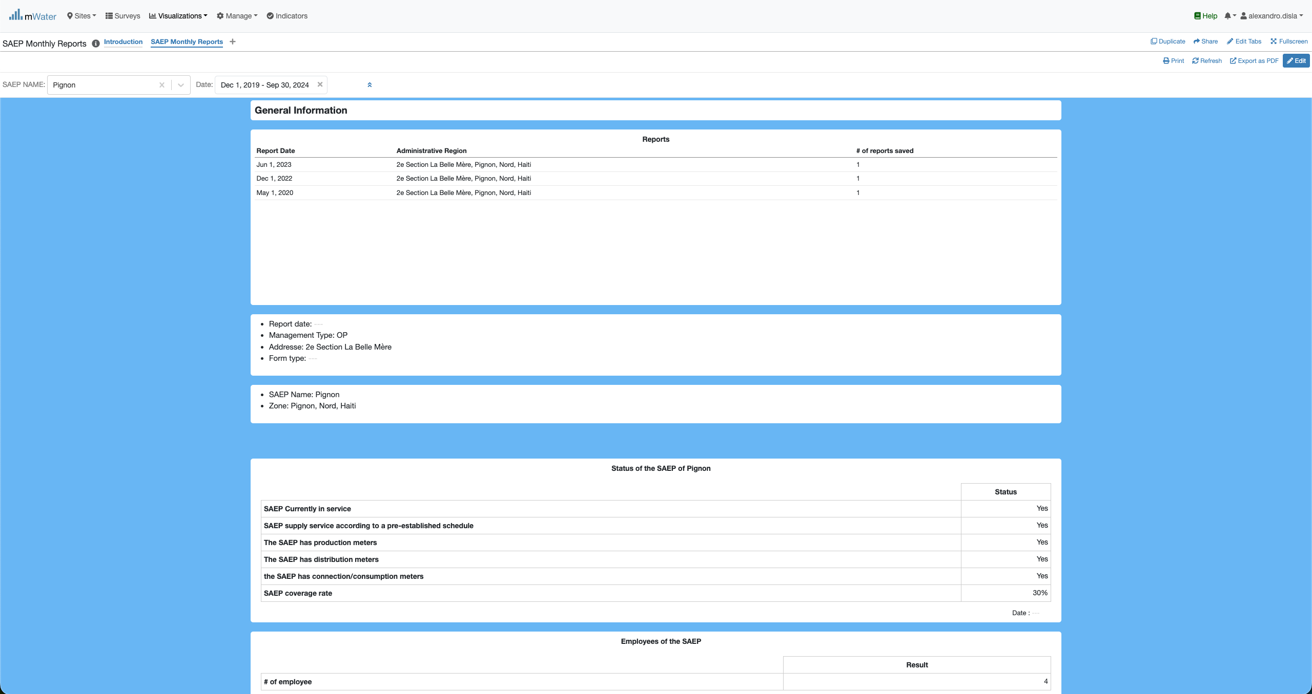
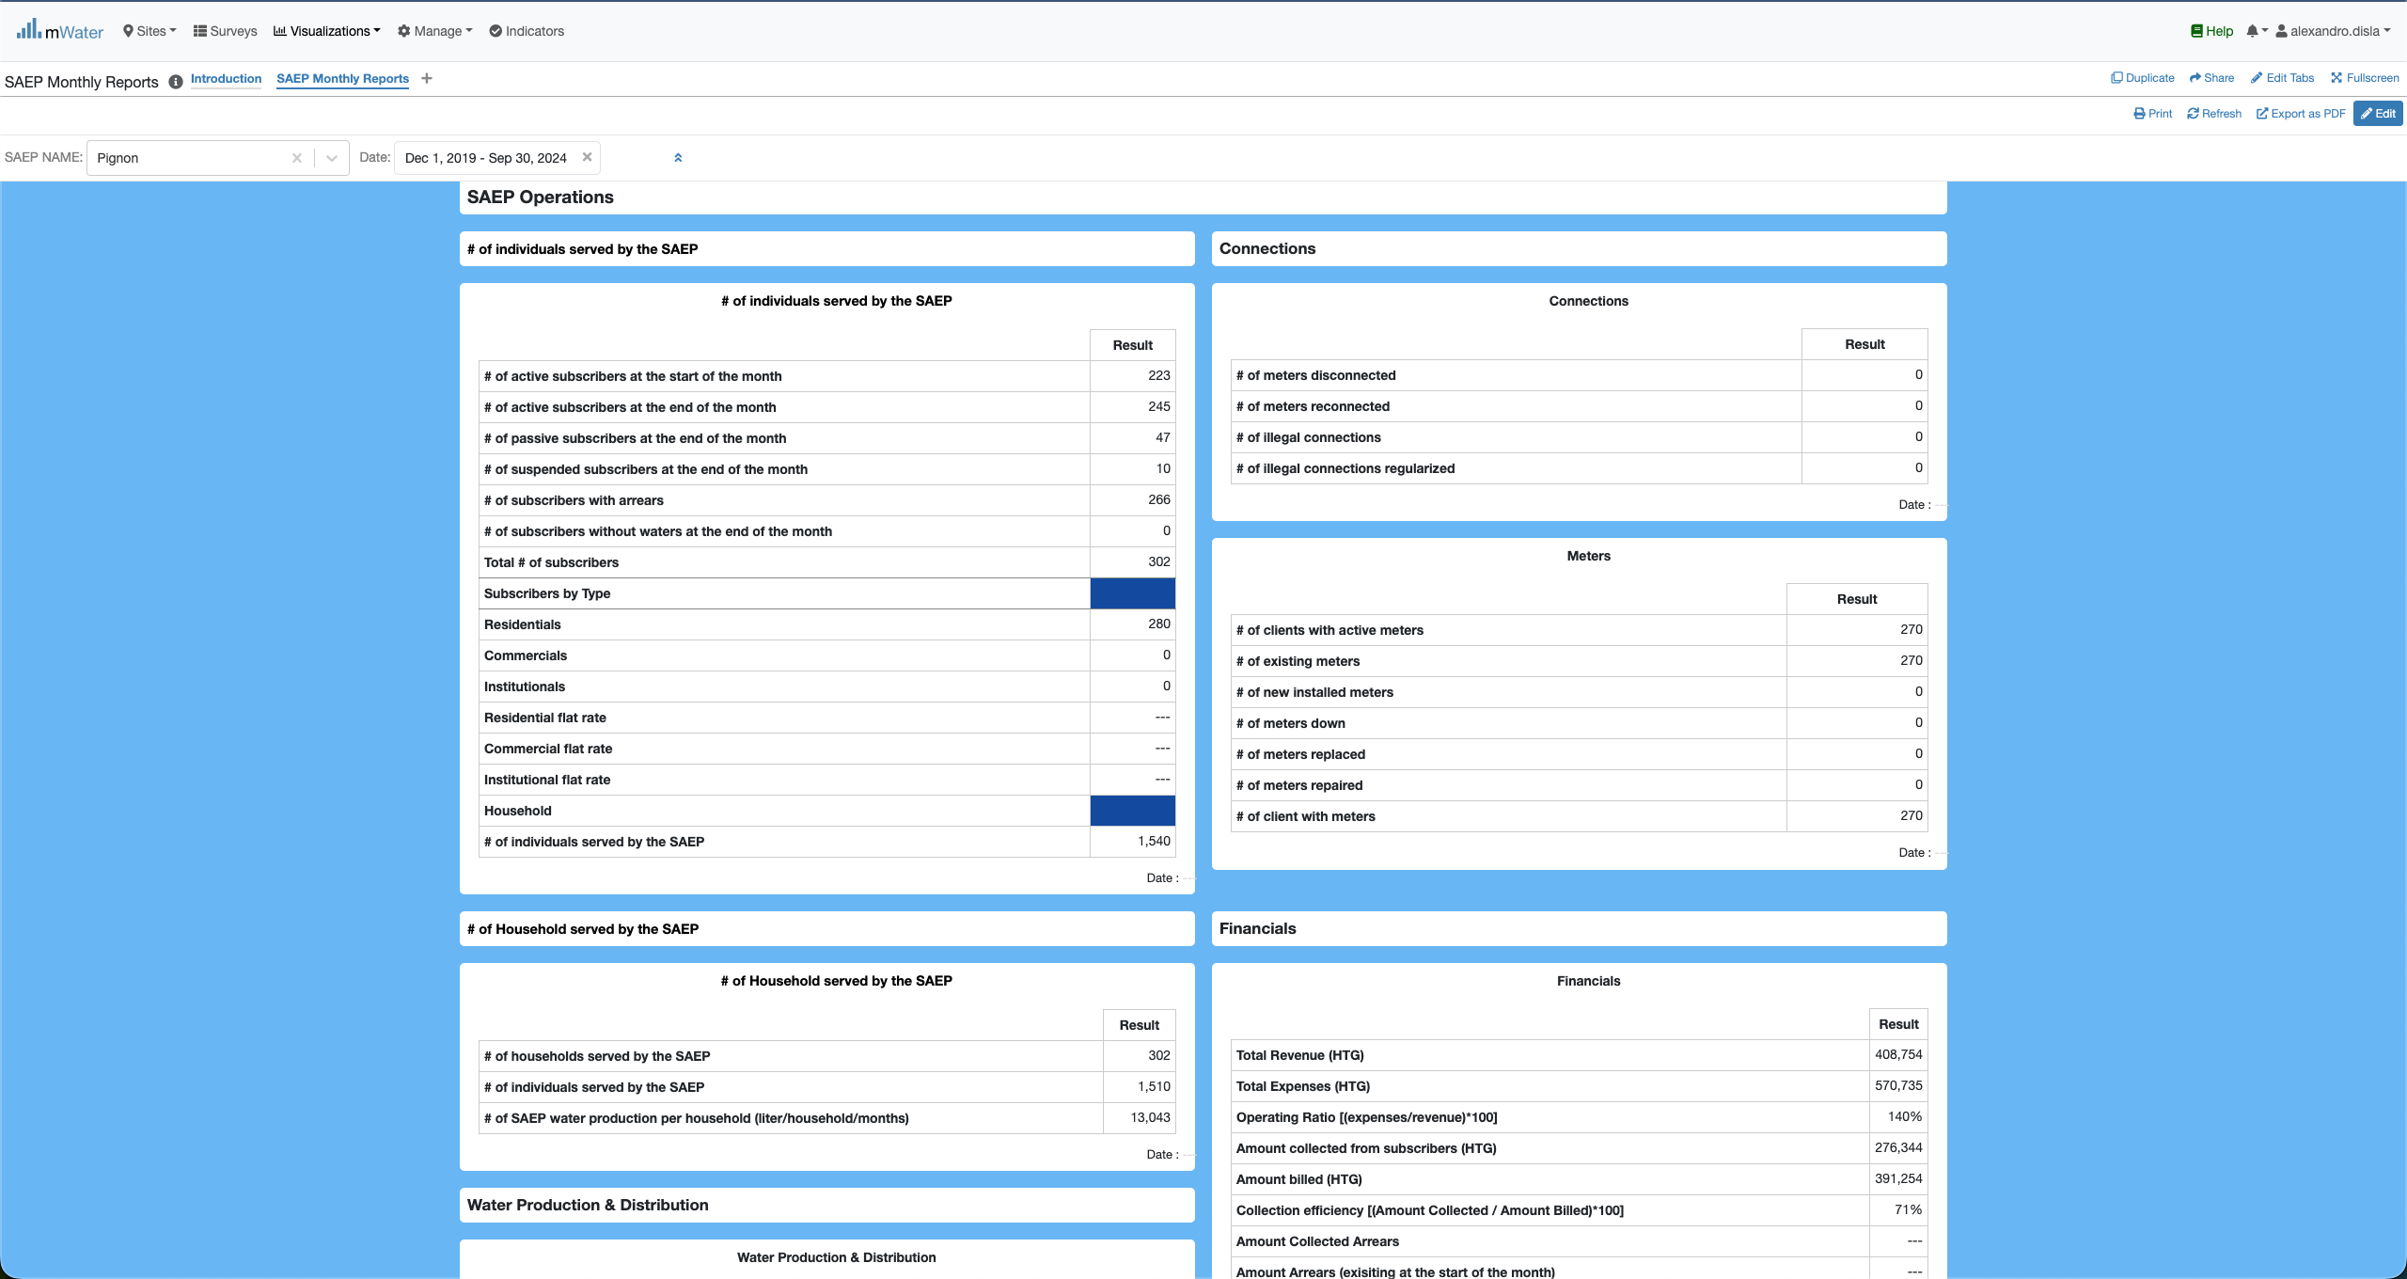
Quick Filters Selection
The General information section
The saep operation section

Slide 24
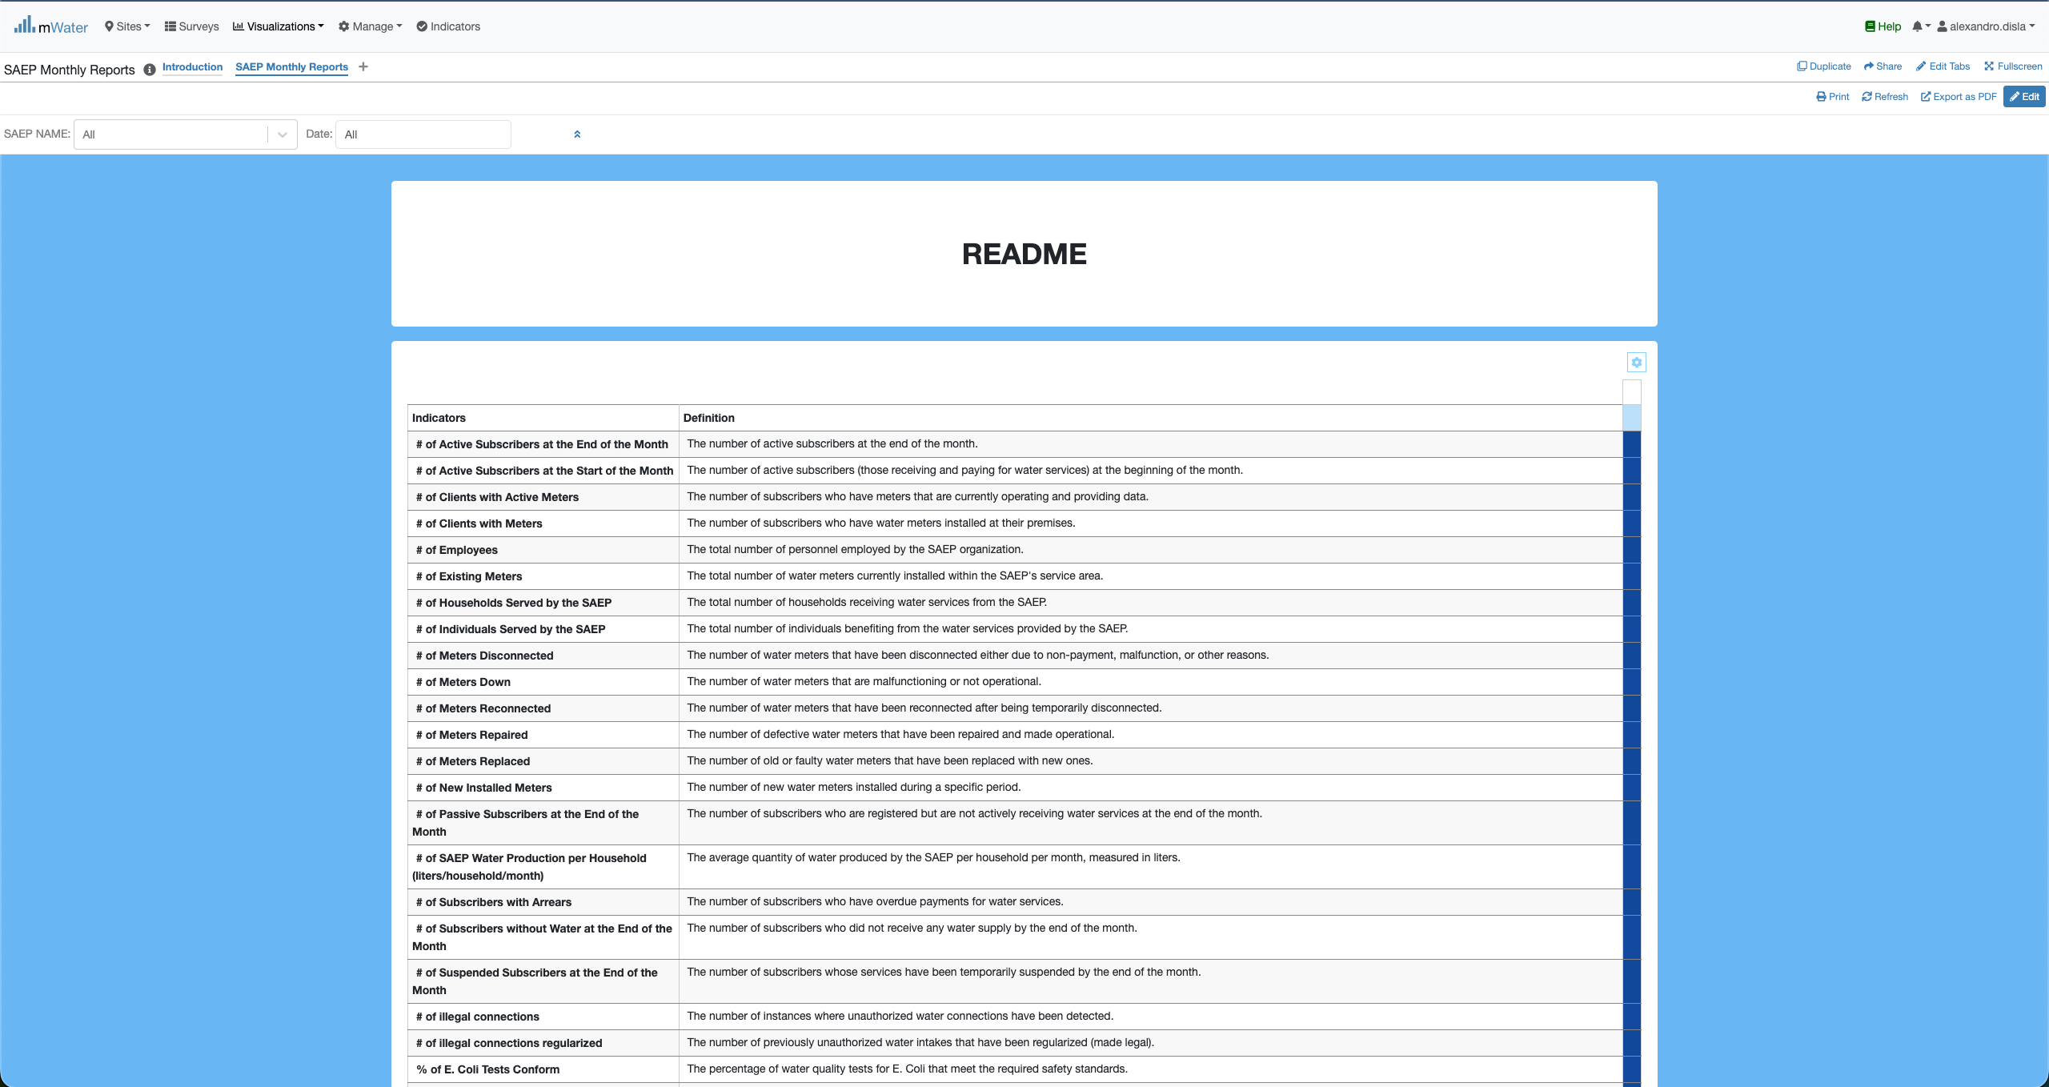
Readme section
This readme is in place to help better understand the key information displayed in the general information and operation sections.

Slide 25
Export

Slide 26
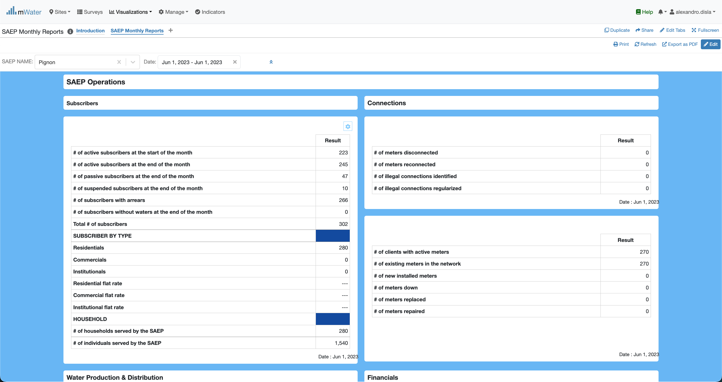
Export from the tables
Hover the cursor over one of the table of your choice. And you click on this button

Slide 27

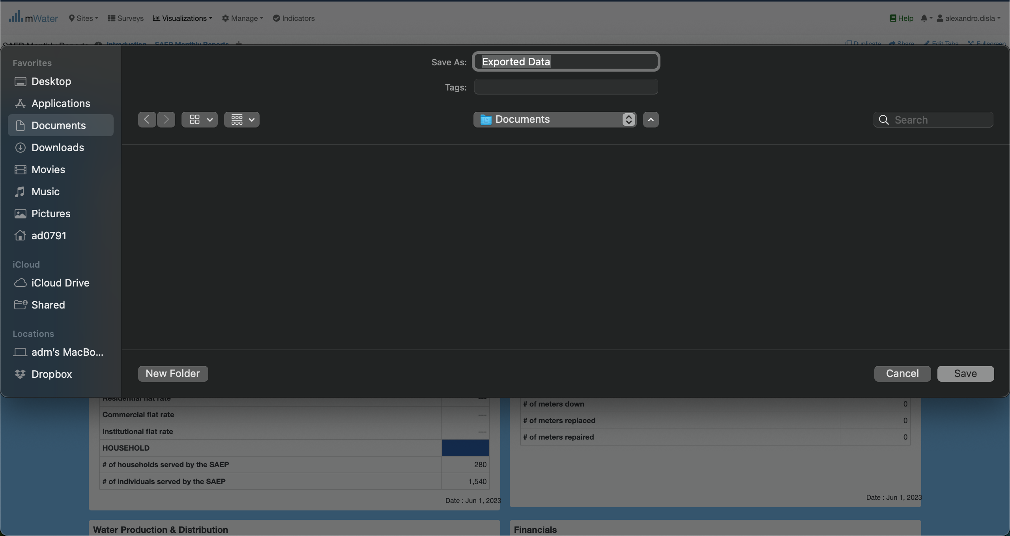
Export from the tables
This will trigger the modal with the download platform.
You can change the name of the export as well as the target location as you see fit.
Depending of your operating system, the export will be saved either on Documents or Downloads

Slide 28
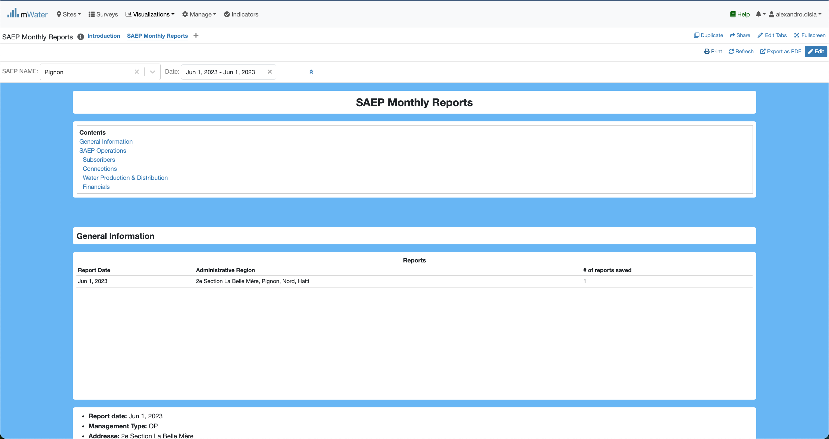
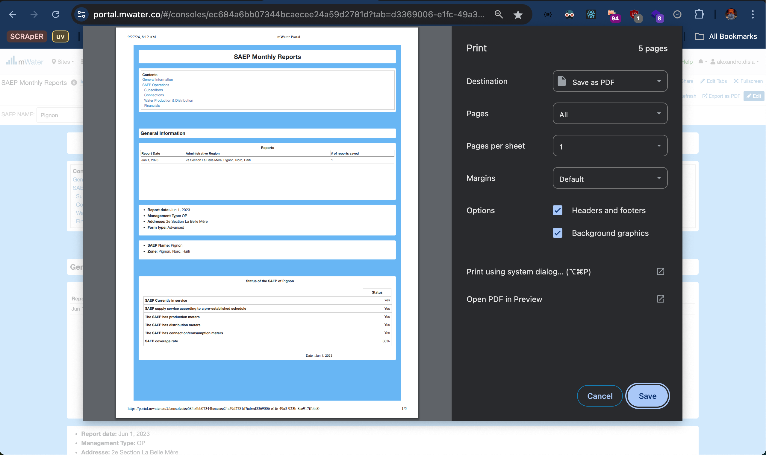
Print Export
The print Icon is another option available.
A very clear interface will help you extract the report in pdf format for your convenience.

Slide 29
Thank You !!!
PLEASE FEEL FREE TO CONTACT ME BY :
Email / alexandro.disla@hanwash.org
Whatsap or Phone / +50941483700

